Slide 1



Round 1 Submission
Team Name: SafeSight
Chosen Track: Women’s Safety
Team Lead Name: Irfan Khan A
Team Lead Contact: 8220791013

Slide 2


Team Details
Name | Department | Year | College
Arshiya A | Artificial Intelligence and Data Science | II | Sri Eshwar College of Engineering
Atharsha P | Artificial Intelligence and Data Science | II | Sri Eshwar College of Engineering
Bavishnavi S | Artificial Intelligence and Data Science | II | Sri Eshwar College of Engineering
Irfan Khan A | Artificial Intelligence and Data Science | II | Sri Eshwar College of Engineering

Slide 3
Problem Statement
Women’s safety is a major concern, especially in isolated and low-lit areas where incidents of harassment and assault are more common. With over 300,000 crimes against women reported in India in 2023, existing safety measures often fail to provide timely help during emergencies. This limits women’s freedom and sense of security. How can we use technology to create a safer environment and offer real-time support when it’s needed most?

Slide 4
Proposed Solution
App Features:
SOS Alert System: Instantly send alerts with real-time location to pre-saved contacts.
Real-Time Location Tracking: Continuously share the user’s location with trusted contacts.
Gesture-Based SOS Activation: Activate emergency alerts through simple gestures.
Safe Zones Identification: Display nearby safe zones like police stations or hospitals.
Direct Chat with Authorities: Enable direct communication with police during emergencies.
Audio/Video Recording: Start recording during an incident and store footage securely.
Bluetooth/USSD Communication: Send alerts even in areas with poor network connectivity.
Dashboard for Law Enforcement: A platform for authorities to monitor real-time incidents.
ML Models:
Person Detection & Gender Classification: AI models to identify individuals and determine their gender.
Anomaly Detection: Models to detect situations like a lone woman at night or a woman surrounded by men.
Gesture Recognition: Detect specific gestures (e.g., shaking the phone) to trigger SOS alerts.
Contextual Analysis: Analyze video feeds or sensor data to send automated alerts in emergencies.
Audio/Video Analysis: Analyze recorded audio and video during incidents for evidence documentation.

Slide 5
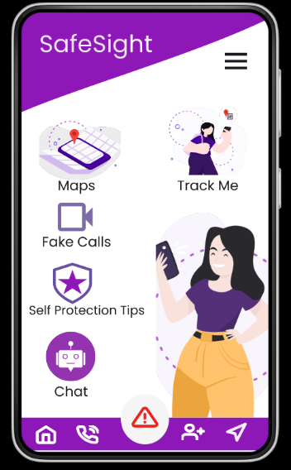
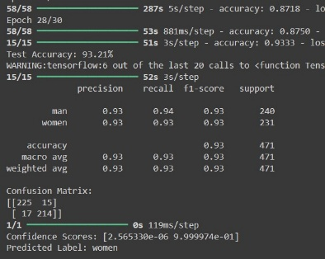
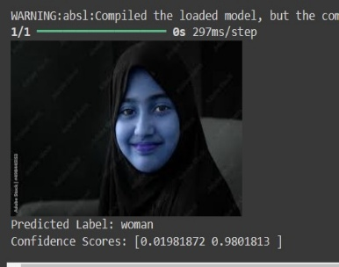
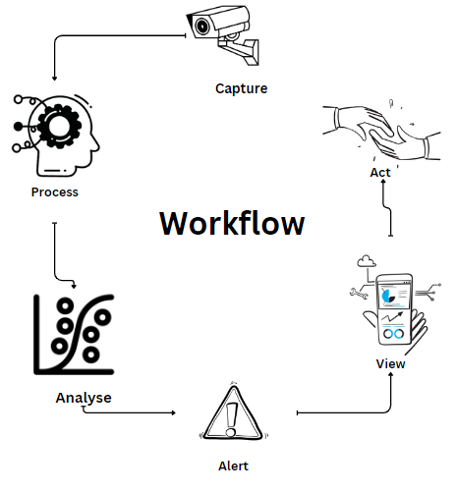
High Level Design

Slide 6
















Tech Specifications
App
Face Recognition
React native
APIs
Backend
TensorFlow/PyTorch
Twilio (SMS alerts)
Google Maps (location).
Node.js with Express
FaceNet/YOLO
or
Database
Python
Cloud
Hardware
AWS/Google Cloud for storage
PostgreSQL/MongoDB
Integrated CCTV for real-time video

Slide 7
Innovation and Uniqueness
Offline Communication Support: Utilizes Bluetooth, USSD, and Wi-Fi Direct to allow emergency alerts even without network connectivity, covering potential dead zones
Anomaly-Based Alerts: Automatically triggers alerts based on unusual situations like a lone woman in unsafe conditions or when surrounded by groups, adding an extra layer of security through proactive monitoring.
Gesture-Activated SOS: Enables emergency alerts via specific gestures (like shaking the phone), providing a discreet and quick way to seek help.
Safe Route Mapping: Recommends the safest routes to users based on real-time and historical data, guiding them away from high-risk areas.
Contextual AI Detection: Uses machine learning to analyze real-time video or sensor data for contextual emergencies, ensuring immediate responses to potential threats.
Contextual Anomaly Detection: Uses AI-driven analysis to detect risky situations (like a lone woman at night or being surrounded by men) in real time, proactively sending alerts even before a manual SOS is triggered.
Gesture-Based SOS Activation: Allows users to activate an emergency alert discreetly through specific gestures, such as shaking the phone, providing a quick and inconspicuous way to call for help.
Offline Communication Support: Integrates Bluetooth, USSD, and Wi-Fi Direct to send alerts even in areas without network coverage, ensuring connectivity in critical moments.
Safe Route Mapping: Suggests the safest travel routes by avoiding high-risk areas based on real-time and historical incident data, empowering users to make safer travel choices.
Companion Mode and Direct Chat: Offers continuous location sharing and a direct chat with nearby security or police, allowing real-time assistance and support from trusted contacts and authorities.

Slide 8
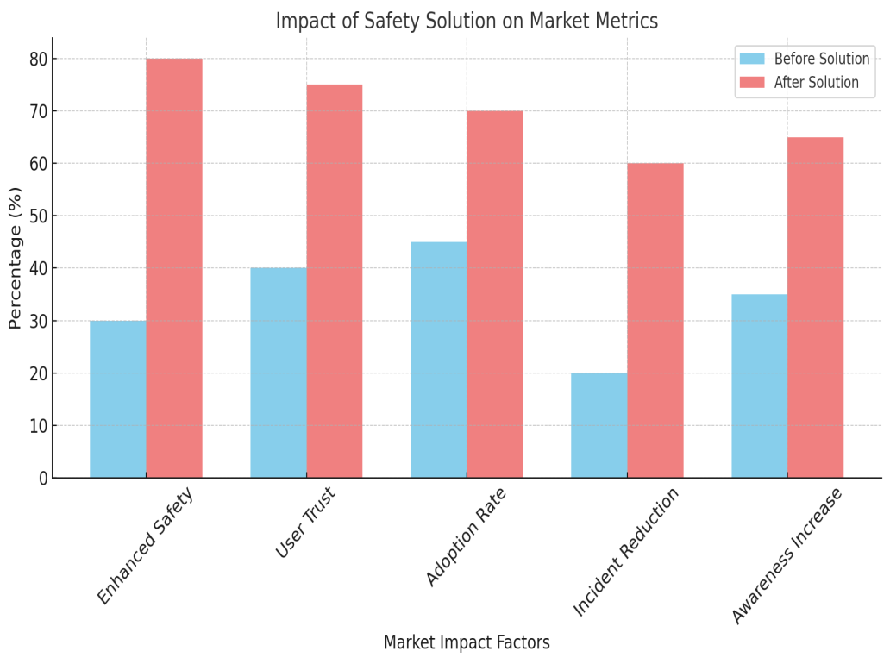
Market Fit
Women Safety Concerns: 80% – Highlights the urgency in addressing safety needs for women.
Adoption of Safety Apps: 60% – Indicates a growing market for reliable, comprehensive safety applications.
Awareness of Unsafe Areas: 50% – Reflects users' interest in apps that inform about local risks.
Use of AI in Public Safety: 40% – Shows the increasing role of AI for real-time monitoring and prevention.
Preference for Privacy in Safety Apps: 70% – Emphasizes the need for secure, privacy-centered features.

Slide 9
Challenges and Risks
Integration with Emergency Services: Collaborating effectively with law enforcement or emergency responders may be difficult due to differing protocols or limitations in real-time data sharing.
Maintenance and Updates: Continuous improvements are needed to keep AI models and app functionalities updated with evolving threats and feedback, which requires resources for long-term maintenance.
Battery and Resource Use: Continuous location sharing, real-time monitoring, and other intensive operations can impact battery life and device performance, potentially inconveniencing users.
Legal and Ethical Challenges: Implementation in different regions may encounter varying legal restrictions, and ethical concerns around surveillance must be handled thoughtfully to avoid potential backlash.
User Trust and Engagement: Ensuring users trust the system enough to adopt it consistently can be challenging. Clear communication about data privacy, along with intuitive features, is critical for building confidence.

Slide 10
Future Scope
Enhanced Machine Learning: Improve model accuracy and introduce adaptive learning for real-time responsiveness.
Broader Features: Implement multi-language support, personalized safety plans, and community-driven safety features.
Expanded Data Utilization: Leverage geospatial analytics and collaborate with smart city initiatives for proactive safety measures.
Improved User Experience: Focus on user-centric design and customization options for better engagement.
Collaboration and Partnerships: Work with law enforcement and NGOs to enhance response protocols and promote the app.
Advanced Connectivity: Explore IoT integration and global connectivity solutions for broader reach.
Market Expansion: Scale to international markets and corporate partnerships for employee safety.

Slide 11
Prototype Demonstration
https://youtu.be/NXa3-X1oQOM?si=w_W4TZGLkdO2cEiQ

